Slide 1
Idea
We are presenting CiakTime, an app designed for cinema lovers.
This app offers the following functionalities:
Search for movies by title and for members of the cast
Read information about plot, cast, year of release, duration, genre, movie director and streaming platform on which the movie is available
Look for popular and upcoming movies
Keep track of already watched movies
Add new movies in a watchlist to track the movie the user wants to watch
Add movies to “favourite movies” list
Review and rate watched movies
Comment and like reviews made by other users
CiakTime
Pagina <number>
Mauro Ficorella - Valentina Sisti - Martina Turbessi

Slide 2



User profile
Age | 18-50 years
Gender
Profession | Any
Education | Any
Location | Any
Technology | Basic smartphone experience
Passions | Cinema, movies
CiakTime
Pagina <number>
Mauro Ficorella - Valentina Sisti - Martina Turbessi

Slide 3
Prototype 0 – Search for a movie
Search the movie “Harry Potter and the Deathly Hallows - Part 2” to see the movie details.
Action 1: open the application (assuming that the user is already logged in)
Response 1: homepage is opened
Action 2: tap on the search icon
Response 2: the search page is displayed
Action 3: tap on the search bar
Response 3: the keyboard shows up
Action 4: type “Harry Potter”
Response 4: each digit is displayed as typed and the system shows the
corresponding results
Action 5 – 6 – 7: [OPTIONAL] tap on filters’ icon, select “most recent” filter and tap on
apply
Response 7: the system shows the results according to the chosen filter
Action 8: select “Harry Potter and the Deathly Hallows - Part 2” from the list of the results
Response 8: the systems shows the page of the selected movie containing all the
related details
CiakTime
Pagina <number>
Mauro Ficorella - Valentina Sisti - Martina Turbessi

Slide 4
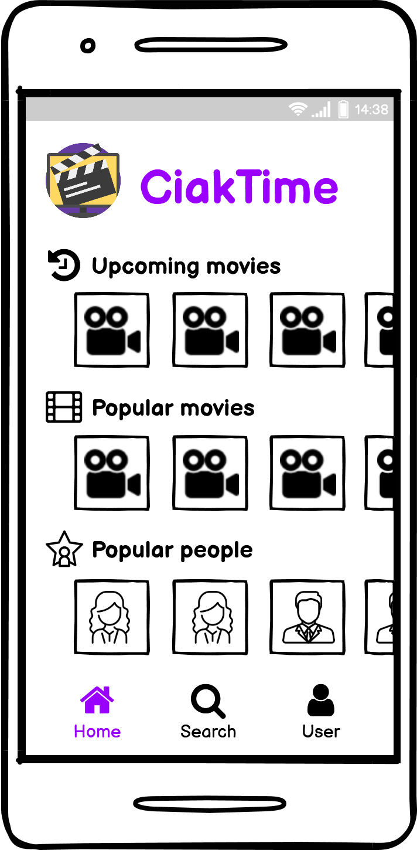
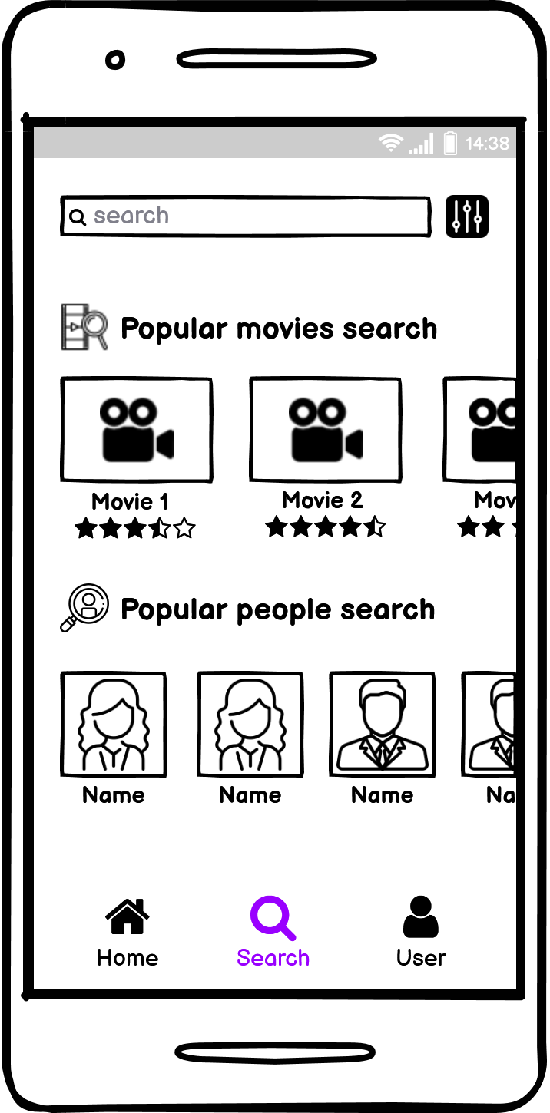
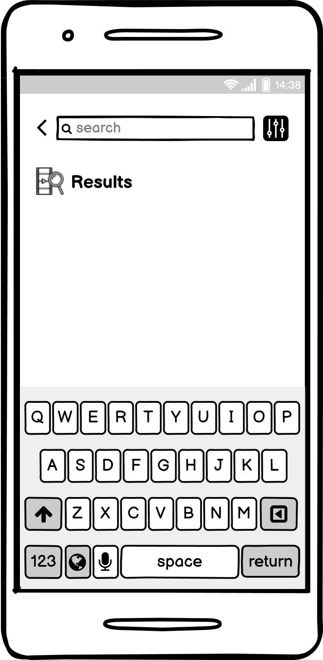
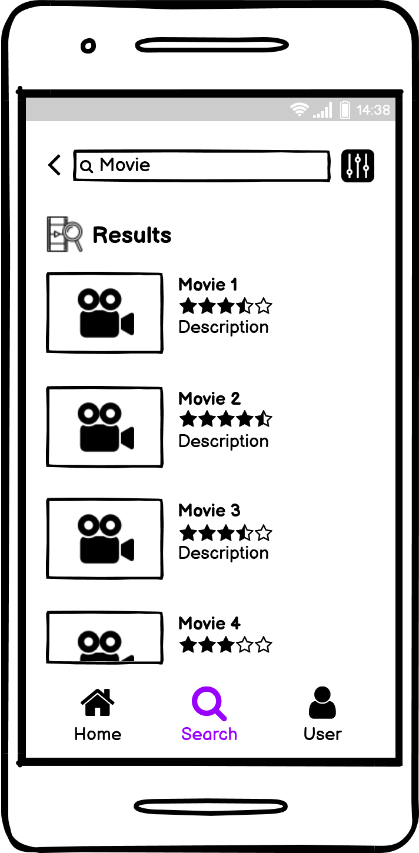
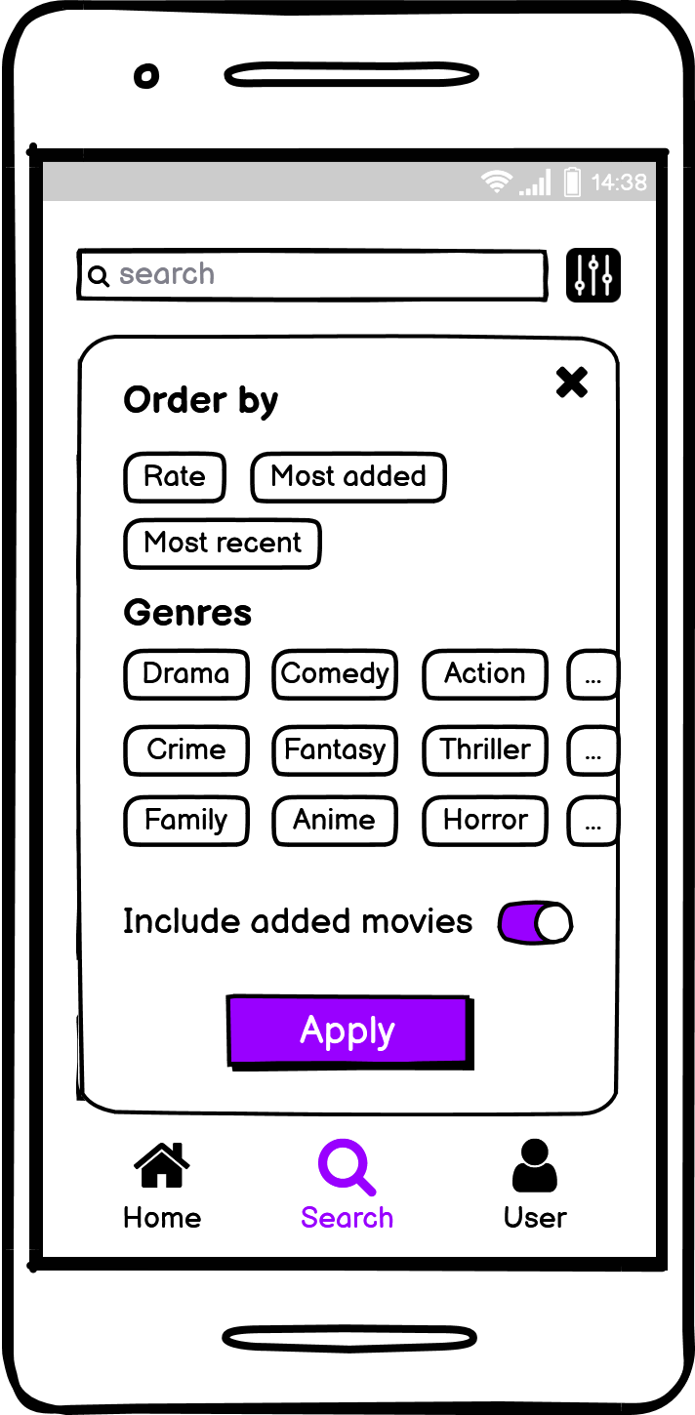
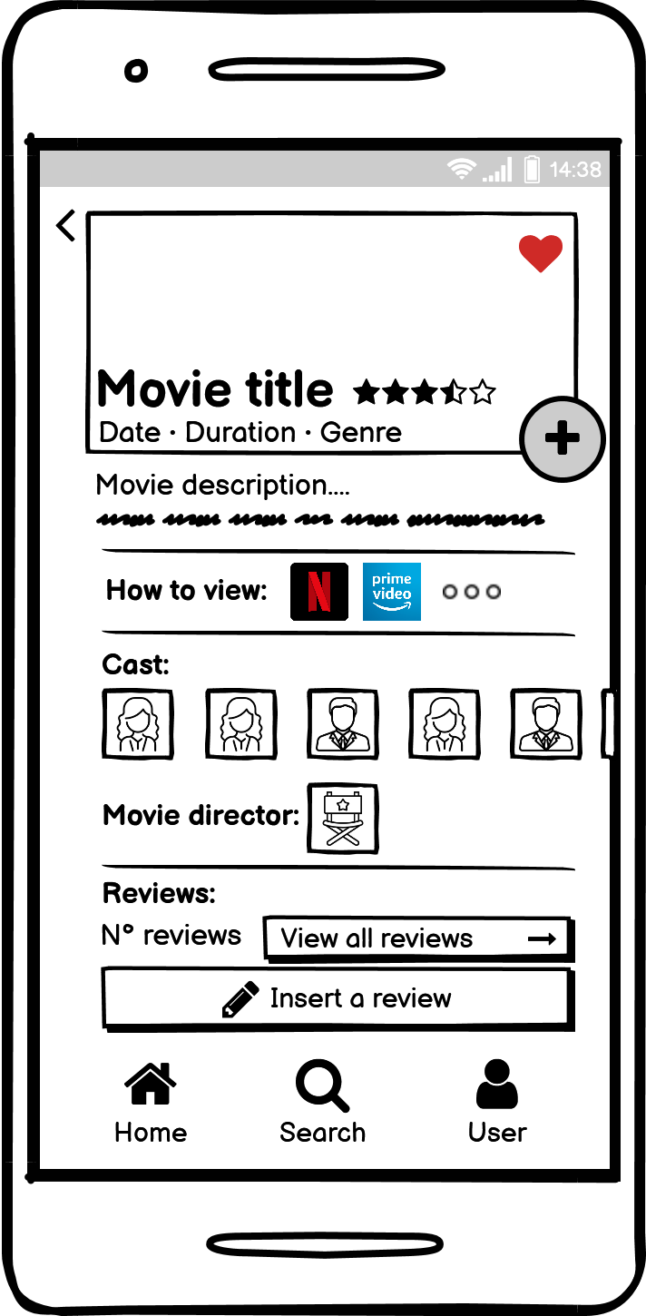
Prototype 0 – Search for a movie
CiakTime
Pagina <number>
Mauro Ficorella - Valentina Sisti - Martina Turbessi

Slide 5
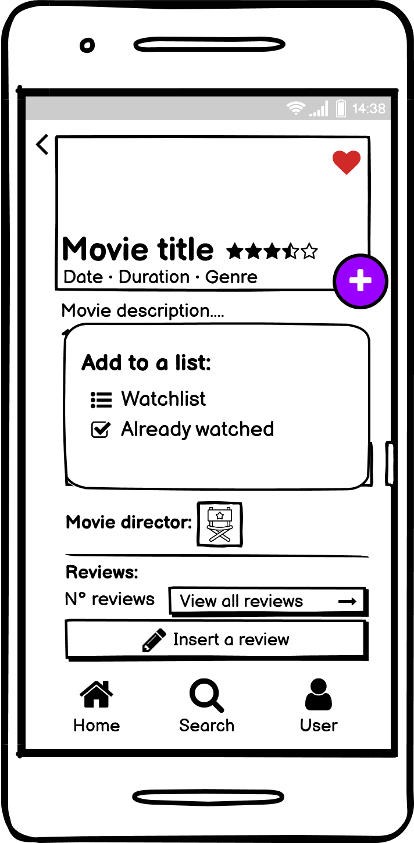
Prototype 0 – Add a movie to watchlist
Add a popular movie to the watchlist.
Action 1: open the application (assuming that the user is already logged in)
Response 1: homepage is opened
Action 2: tap on a movie from “popular movies” section
Response 2: the movies page is displayed
Action 3: tap on the “+” button
Response 3: lists’ popup is displayed
Action 4: tap on watchlist
Response 4: the movie is added to watchlist
CiakTime
Pagina <number>
Mauro Ficorella - Valentina Sisti - Martina Turbessi

